Slide 1
CS 2002 Artificial Intelligence
Waheed Ahmed
Email : waheedahmed@nu.edu.pk

Slide 2
Week 9: Bayes Net & HMM Russell & Norvig, Chapter 14.
(Most of slides from Dan Klein, Pieter Abbeel)

Slide 3
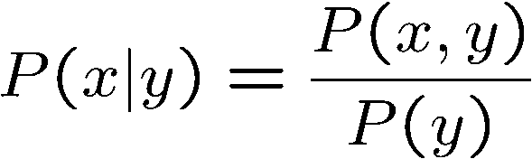
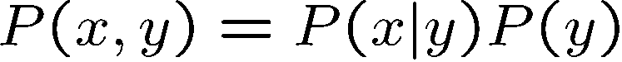
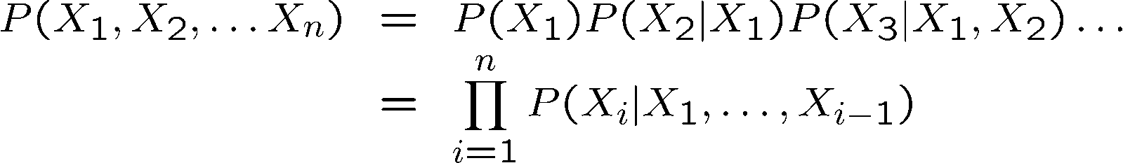
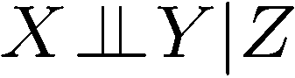
Probability Recap
Conditional probability
Product rule
Chain rule
X, Y independent if and only if:
X and Y are conditionally independent given Z if and only if:

Slide 4

Probabilistic Models
Models describe how (a portion of) the world works
Models are always simplifications
May not account for every variable
May not account for all interactions between variables
“All models are wrong; but some are useful.” – George E. P. Box
What do we do with probabilistic models?
We (or our agents) need to reason about unknown variables, given evidence
Example: explanation (diagnostic reasoning)
Example: prediction (causal reasoning)
Example: value of information
Notes:
George Box: All models are wrong; some of them are useful

Slide 5

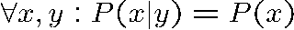
Independence
Two variables are independent if:
This says that their joint distribution factors into a product two simpler distributions
Another form:
The knowledge that one event occurs does not affect the probability of the other event
Independence is a simplifying modeling assumption
Empirical joint distributions: at best “close” to independent
What could we assume for {Weather, Traffic, Cavity, Toothache}?

Slide 6
Example: Independence?
T | P
hot | 0.5
cold | 0.5
T | W | P
hot | sun | 0.4
hot | rain | 0.1
cold | sun | 0.2
cold | rain | 0.3
T | W | P
hot | sun | 0.3
hot | rain | 0.2
cold | sun | 0.3
cold | rain | 0.2
W | P
sun | 0.6
rain | 0.4

Slide 7

Conditional Independence
P(Toothache, Cavity, Catch)
If I have a cavity, the probability that the probe catches in it doesn't depend on whether I have a toothache:
P(+catch | +toothache, +cavity) = P(+catch | +cavity)
The same independence holds if I don’t have a cavity:
P(+catch | +toothache, -cavity) = P(+catch| -cavity)
Catch is conditionally independent of Toothache given Cavity:
P(Catch | Toothache, Cavity) = P(Catch | Cavity)
Equivalent statements:
P(Toothache | Catch , Cavity) = P(Toothache | Cavity)
P(Toothache, Catch | Cavity) = P(Toothache | Cavity) P(Catch | Cavity)
One can be derived from the other easily

Slide 8
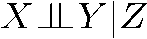
Conditional Independence
Unconditional (absolute) independence very rare (why?)
Conditional independence is our most basic and robust form of knowledge about uncertain environments.
X is conditionally independent of Y given Z
if and only if:
or, equivalently, if and only if

Slide 9
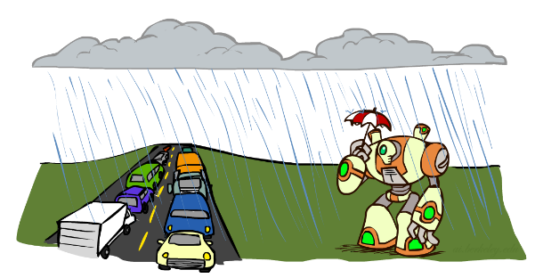
Conditional Independence
What about this domain:
Traffic
Umbrella
Raining

Slide 10
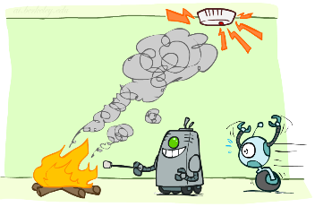
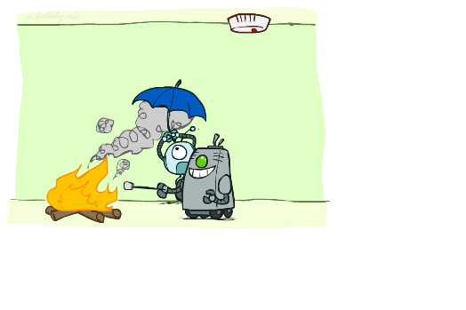
Conditional Independence
What about this domain:
Fire
Smoke
Alarm

Slide 11

Conditional Independence and the Chain Rule
Chain rule:
Trivial decomposition:
With assumption of conditional independence:
Bayes’nets / graphical models help us express conditional independence assumptions

Slide 12
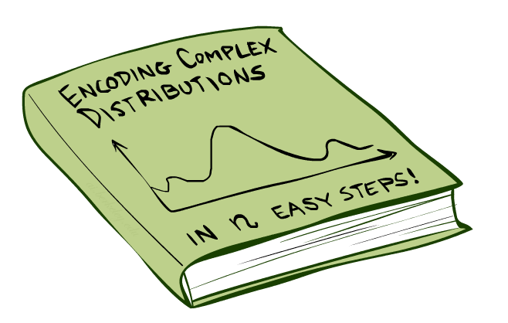
Bayes’Nets: Big Picture
Bayesian network: data structure that represents the
dependencies among random variables:
A Bayesian network is a representation of a joint probability distribution of a set of random variables with a possible mutual causal relationship.

Slide 13
Bayes’ Nets: Big Picture
Two problems with using full joint distribution tables as our probabilistic models:
Unless there are only a few variables, the joint is WAY too big to represent explicitly
Hard to learn (estimate) anything empirically about more than a few variables at a time
Bayes’ nets: a technique for describing complex joint distributions (models) using simple, local distributions (conditional probabilities)
More properly called graphical models
We describe how variables locally interact
Local interactions chain together to give global, indirect interactions

Slide 14
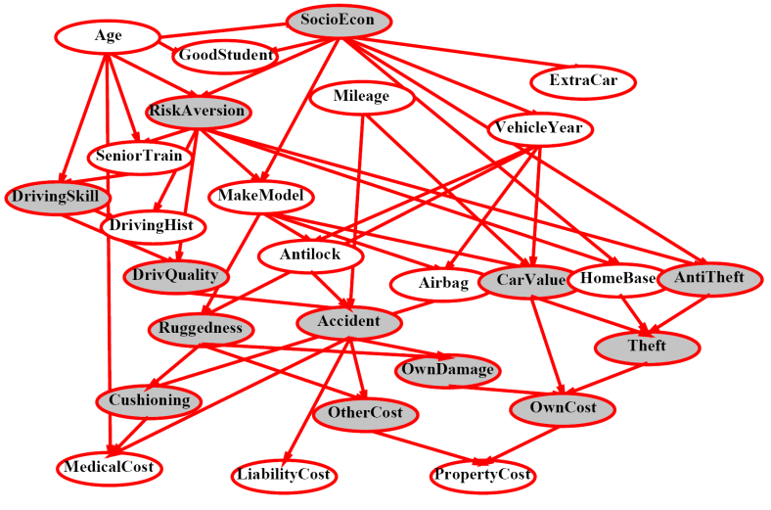
Example Bayes’ Net: Insurance

Slide 15
Example Bayes’ Net: Car

Slide 16
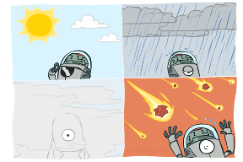
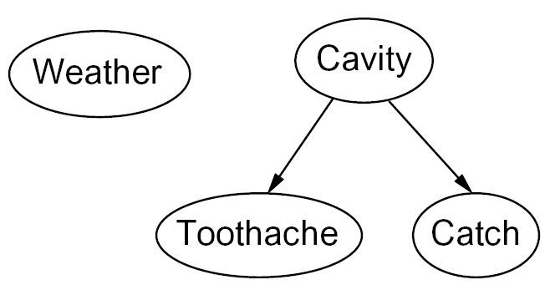

Graphical Model Notation
Nodes: variables (with domains)
Can be assigned (observed) or unassigned (unobserved)
Arcs: interactions
Similar to CSP constraints
Indicate “direct influence” between variables
Formally: encode conditional independence (more later)
For now: imagine that arrows mean direct causation (in general, they don’t!)

Slide 17
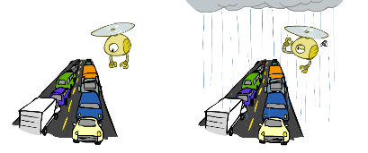
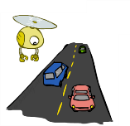
Example: Traffic
Variables:
R: It rains
T: There is traffic
Model 1: independence
Why is an agent using model 2 better?
Model 2: rain causes traffic
R
R
T
T

Slide 18
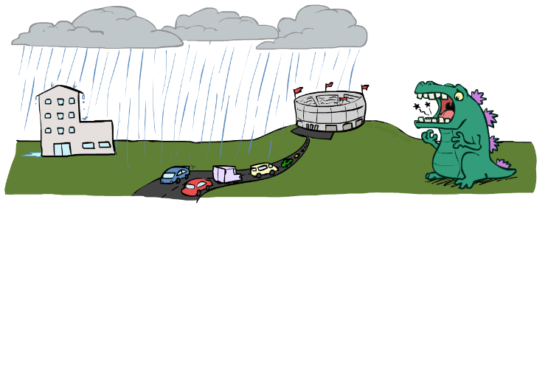
Example: Traffic II
Let’s build a causal graphical model!
Variables
T: Traffic
R: It rains
L: Low pressure
D: Roof drips
B: Ballgame
C: Cavity

Slide 19
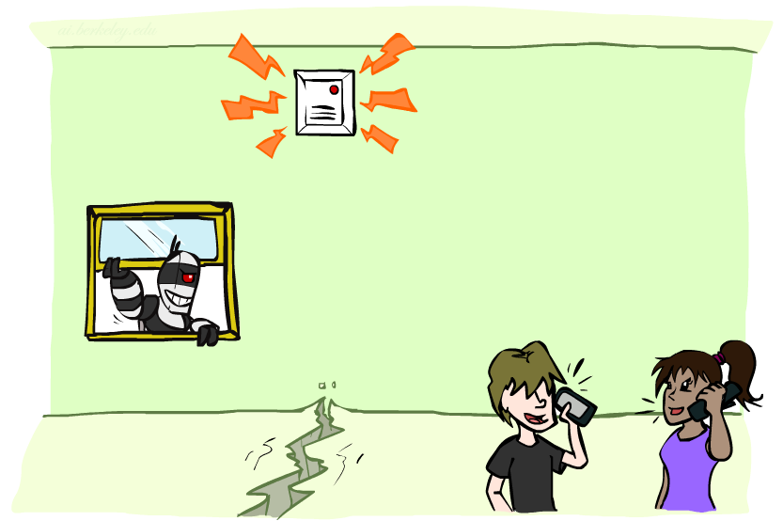
Example: Alarm Network
Variables
B: Burglary
A: Alarm goes off
M: Mary calls
J: John calls
E: Earthquake!

Slide 20
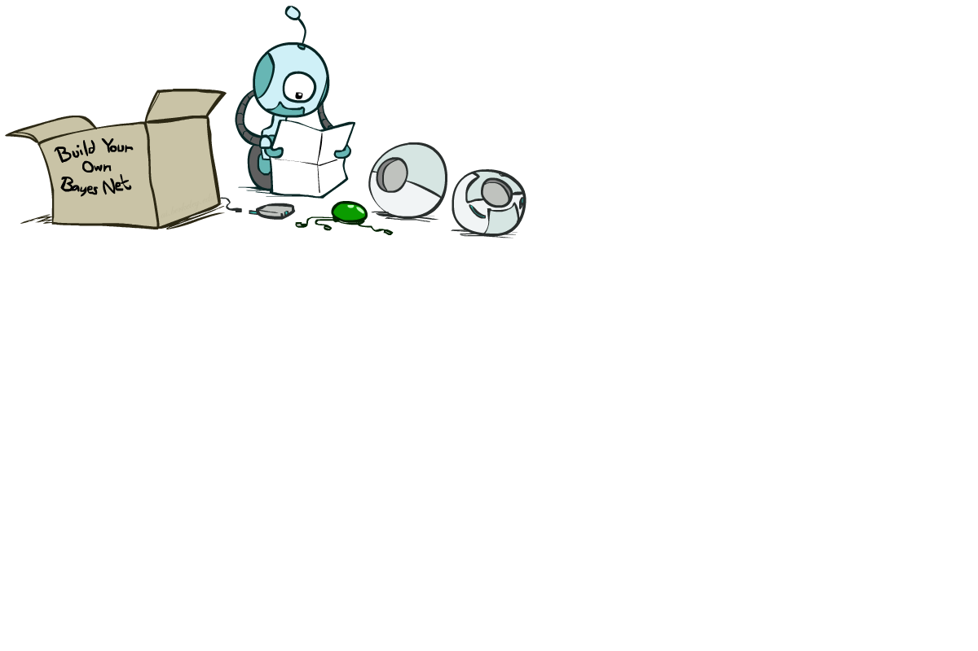
Bayes’ Net Semantics

Slide 21
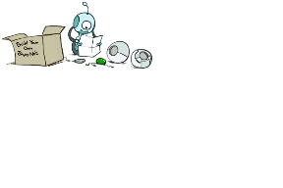
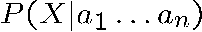
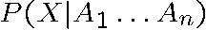
Bayes’ Net Semantics
A set of nodes, one per variable X
A directed, acyclic graph
A conditional distribution for each node
A collection of distributions over X, one for each combination of parents’ values
CPT: conditional probability table
Description of a noisy “causal” process
A₁
A_{n}
X
A Bayes net = Topology (graph) + Local Conditional Probabilities

Slide 22
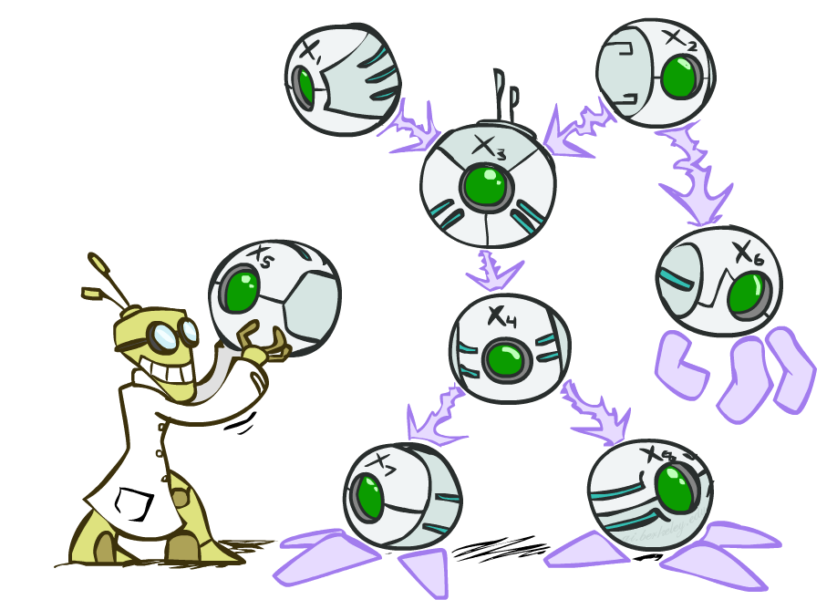
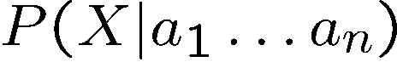
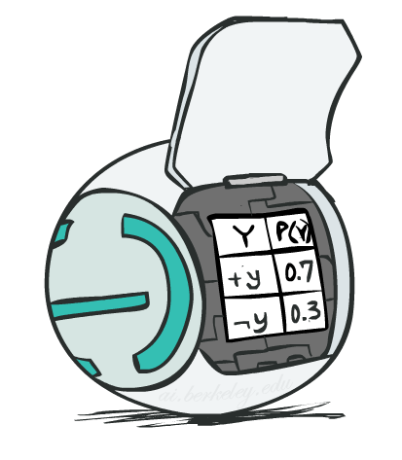
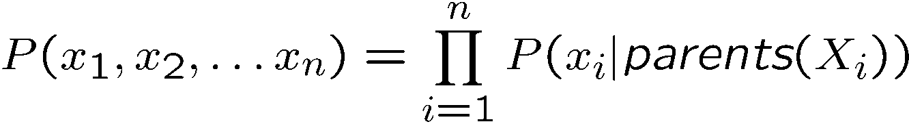
Bayes’ Net Semantics
A directed, acyclic graph, one node per random variable
A conditional probability table (CPT) for each node
A collection of distributions over X, one for each combination of parents’ values
Bayes’ nets implicitly encode joint distributions
As a product of local conditional distributions
To see what probability a BN gives to a full assignment, multiply all the relevant conditionals together:

Slide 23
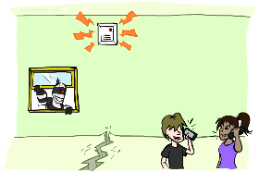
Example: Alarm Network
B | P(B)
+b | 0.001
-b | 0.999
E | P(E)
+e | 0.002
-e | 0.998
Burglary
Earthqk
Alarm
B | E | A | P(A|B,E)
+b | +e | +a | 0.95
+b | +e | -a | 0.05
+b | -e | +a | 0.94
+b | -e | -a | 0.06
-b | +e | +a | 0.29
-b | +e | -a | 0.71
-b | -e | +a | 0.001
-b | -e | -a | 0.999
John calls
Mary calls
A | J | P(J|A)
+a | +j | 0.9
+a | -j | 0.1
-a | +j | 0.05
-a | -j | 0.95
A | M | P(M|A)
+a | +m | 0.7
+a | -m | 0.3
-a | +m | 0.01
-a | -m | 0.99
Notes:
demo

Slide 24

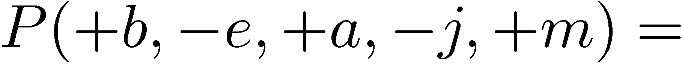
Global semantics (Alarm Network)
B | P(B)
+b | 0.001
-b | 0.999
B
E
E | P(E)
+e | 0.002
-e | 0.998
A
A | J | P(J|A)
+a | +j | 0.9
+a | -j | 0.1
-a | +j | 0.05
-a | -j | 0.95
A | M | P(M|A)
+a | +m | 0.7
+a | -m | 0.3
-a | +m | 0.01
-a | -m | 0.99
B | E | A | P(A|B,E)
+b | +e | +a | 0.95
+b | +e | -a | 0.05
+b | -e | +a | 0.94
+b | -e | -a | 0.06
-b | +e | +a | 0.29
-b | +e | -a | 0.71
-b | -e | +a | 0.001
-b | -e | -a | 0.999
J
M
“Global” semantics defines the full joint distribution as the product of the local conditional distributions:
?
Notes:
demo

Slide 25

Global semantics (Alarm Network)
B | P(B)
+b | 0.001
-b | 0.999
B
E
E | P(E)
+e | 0.002
-e | 0.998
A
A | J | P(J|A)
+a | +j | 0.9
+a | -j | 0.1
-a | +j | 0.05
-a | -j | 0.95
A | M | P(M|A)
+a | +m | 0.7
+a | -m | 0.3
-a | +m | 0.01
-a | -m | 0.99
B | E | A | P(A|B,E)
+b | +e | +a | 0.95
+b | +e | -a | 0.05
+b | -e | +a | 0.94
+b | -e | -a | 0.06
-b | +e | +a | 0.29
-b | +e | -a | 0.71
-b | -e | +a | 0.001
-b | -e | -a | 0.999
J
M
Notes:
demo

Slide 26
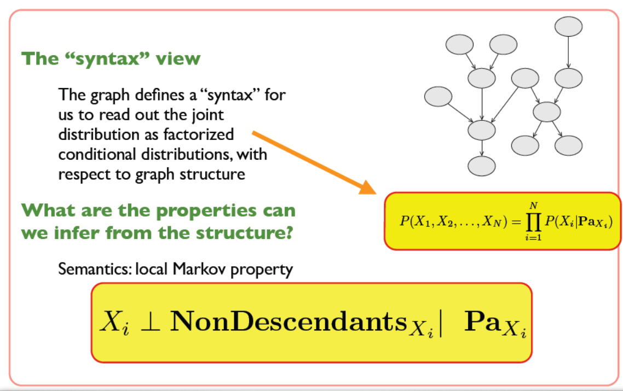
Local semantics

Slide 27
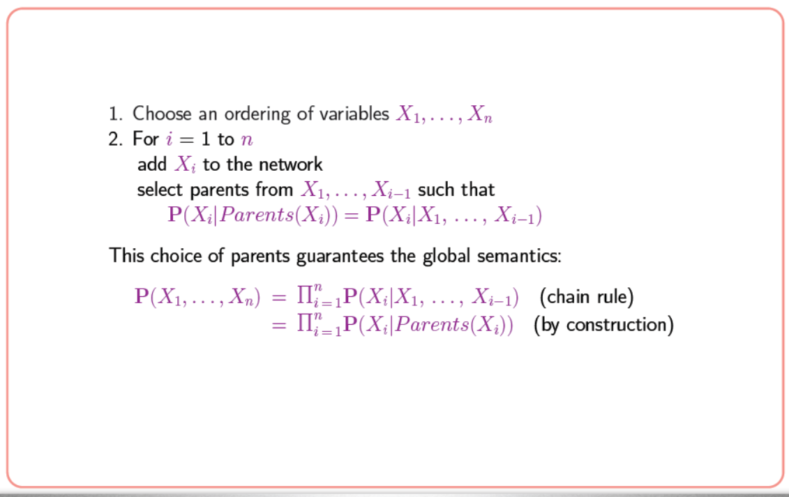
How to construct Bayesian network

Slide 28
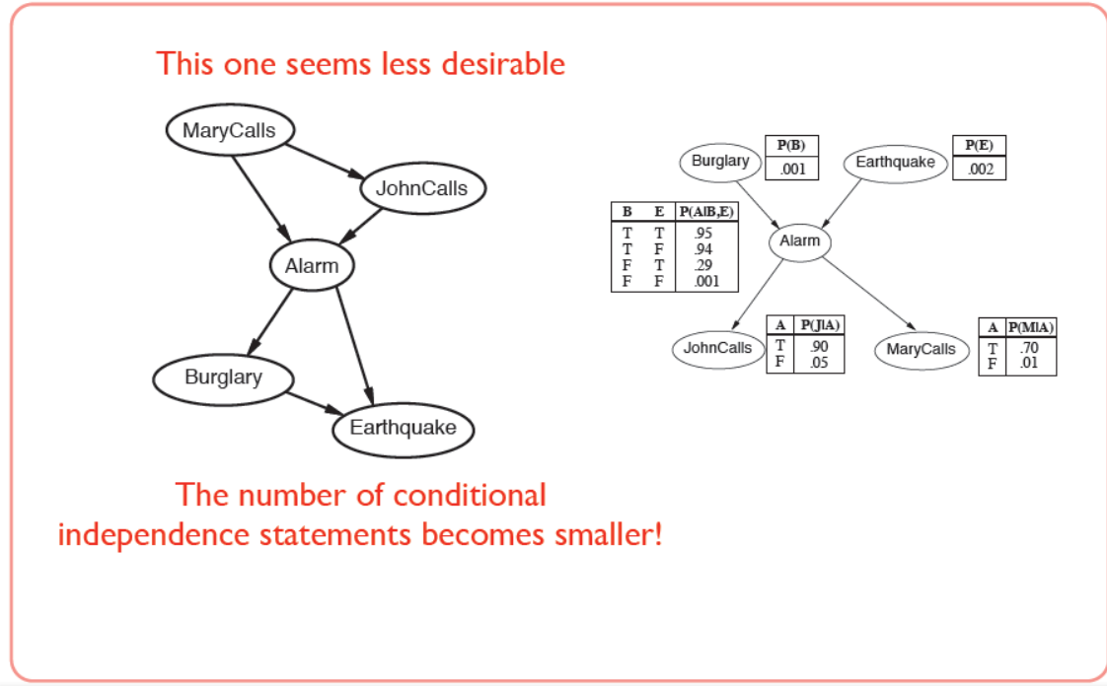
How to construct Bayesian network

Slide 29
Example: Appointment
Rain
{none, light, heavy}
Maintenance
{yes, no}
Train
{on time, delayed}
Appointment
{Attend, miss}
Notes:
0.003

Slide 30
Example: Appointment
Rain
{none, light, heavy}
none | light | heavy
0.7 | 0.2 | 0.1
Notes:
0.003

Slide 31
Example: Appointment
Rain
{none, light, heavy}
Maintenance
{yes, no}
R | Yes | No
none | 0.4 | 0.6
light | 0.2 | 0.8
heavy | 0.1 | 0.9
Notes:
0.003

Slide 32
Example: Appointment
Rain
{none, light, heavy}
R | M | On time | delayed
none | yes | 0.8 | 0.2
none | no | 0.9 | 0.1
light | yes | 0.6 | 0.4
light | no | 0.7 | 0.3
heavy | yes | 0.4 | 0.6
heavy | no | 0.5 | 0.5
Maintenance
{yes, no}
Train
{on time, delayed}
Notes:
0.003

Slide 33
Example: Appointment
Rain
{none, light, heavy}
Maintenance
{yes, no}
Train
{on time, delayed}
T | Attend | Miss
On time | 0.9 | 0.1
delayed | 0.6 | 0.4
Appointment
{Attend, miss}
Notes:
0.003

Slide 34
Example: Appointment
Computing Joint Probability
Rain
{none, light, heavy}
P(light) = P(light)
P(light, no) =
P(light) P(no | light)
Maintenance
{yes, no}
P(light, no, delayed) =
P(light) P(no | light) P (delayed | no, light)
Train
{on time, delayed}
P(light, no, delayed, miss ) =
P(light) P(no | light) P (delayed | no, light) P (miss | no, light, delayed) (Chain Rule)
Appointment
{Attend, miss}
P(light, no, delayed, miss ) =
P(light) P(no | light) P (delayed | no, light) P (miss | delayed) (Bayes Net)
Notes:
0.003

Slide 35
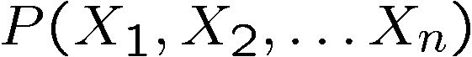
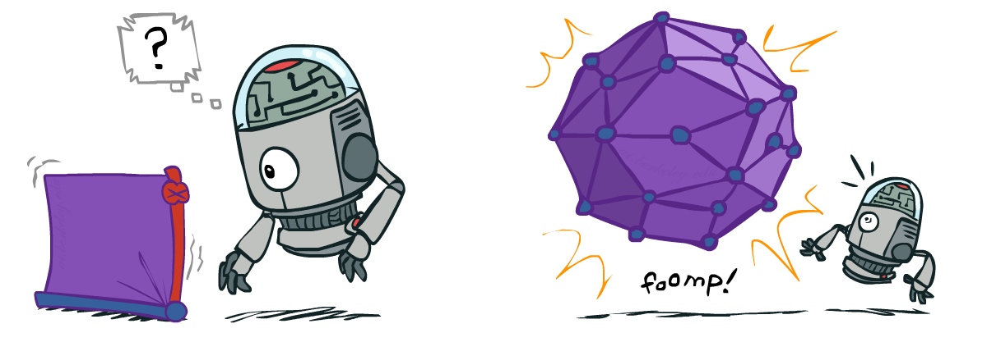
Size of a Bayes’ Net
How big is a joint distribution over N Boolean variables?
2^{N}
How big is an N-node net if nodes have up to k parents?
O(N * 2^{k+1})
Both give you the power to calculate
BNs: Huge space savings!
Also easier to elicit local CPTs
Also faster to answer queries (coming)

Slide 36
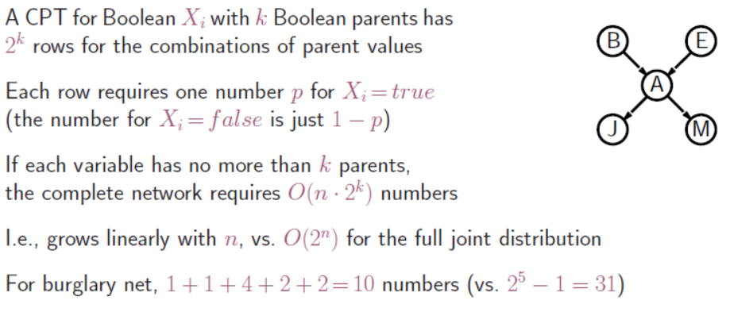
Size of a Bayes’ Net

Slide 37

Bayes’ Nets
Representation
Conditional Independences
Probabilistic Inference
Learning Bayes’ Nets from Data

Slide 38
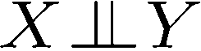
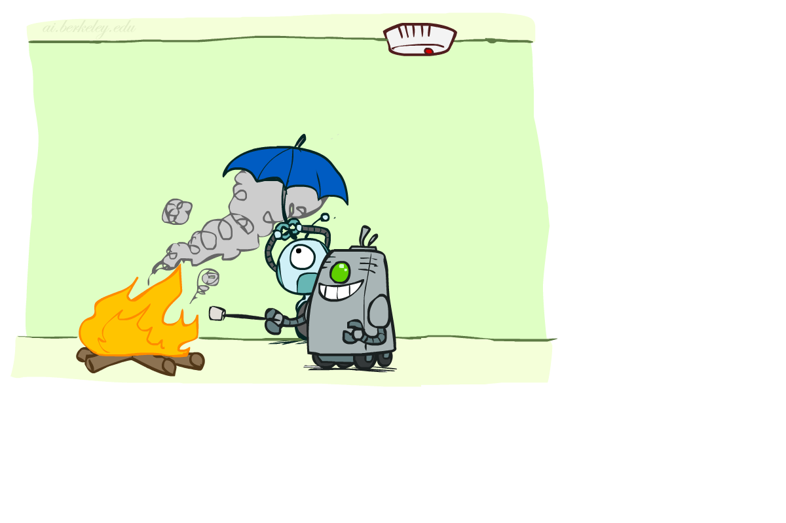
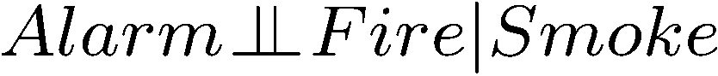
Conditional Independence
X and Y are independent if
X and Y are conditionally independent given Z
(Conditional) independence is a property of a distribution
Example:

Slide 39
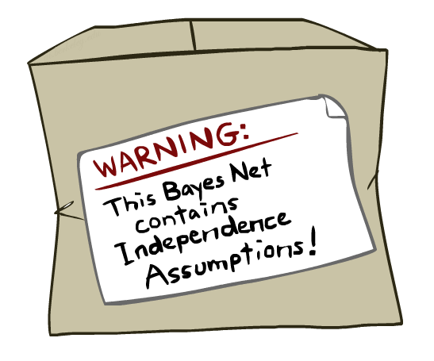
Bayes Nets: Assumptions
Assumptions we are required to make to define the Bayes net when given the graph:
Beyond above “chain rule → Bayes net” conditional independence assumptions
Often additional conditional independences
They can be read off the graph
Important for modeling: understand assumptions made when choosing a Bayes net graph
Notes:
Important for modeling: understanding which assumptions you are making!

Slide 40
Example
X
Y
Z
W
Conditional independence assumptions directly from simplifications in chain rule:
Additional implied conditional independence assumptions?
W ∐ X | Y
P(X, Y, Z, W ) = P(X) P(Y| X) P (Z | X, Y) P (W | X, Y, Z) (Chain Rule)
P(X, Y, Z, W ) = P(X) P(Y| X) P (Z | Y) P (W | Z) (Bayes Net)
W ∐ X, Y | Z

Slide 41
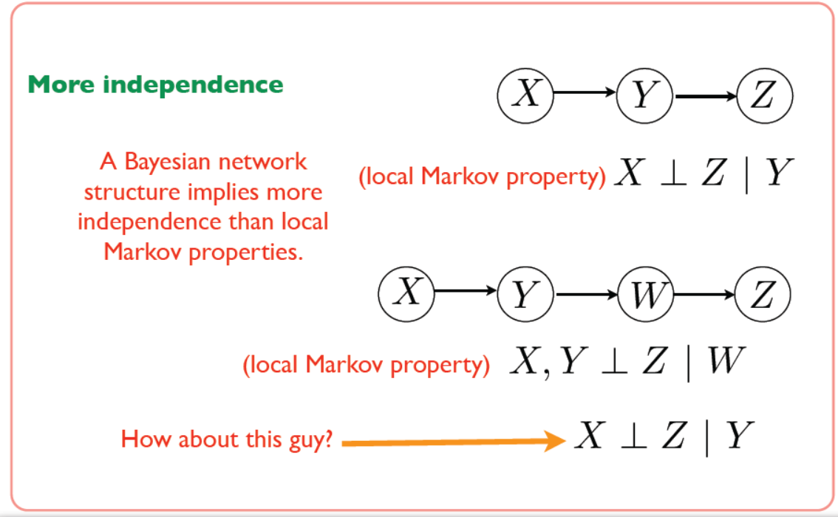
D-separation (Maybe the graph can tell us more)

Slide 42
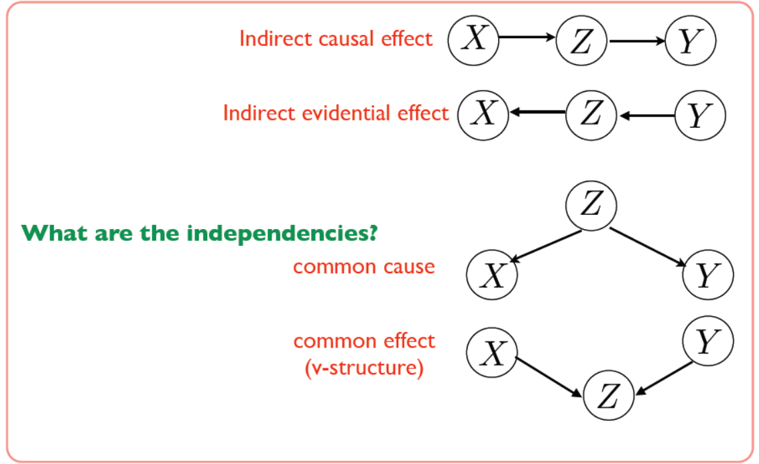
Simple Cases

Slide 43
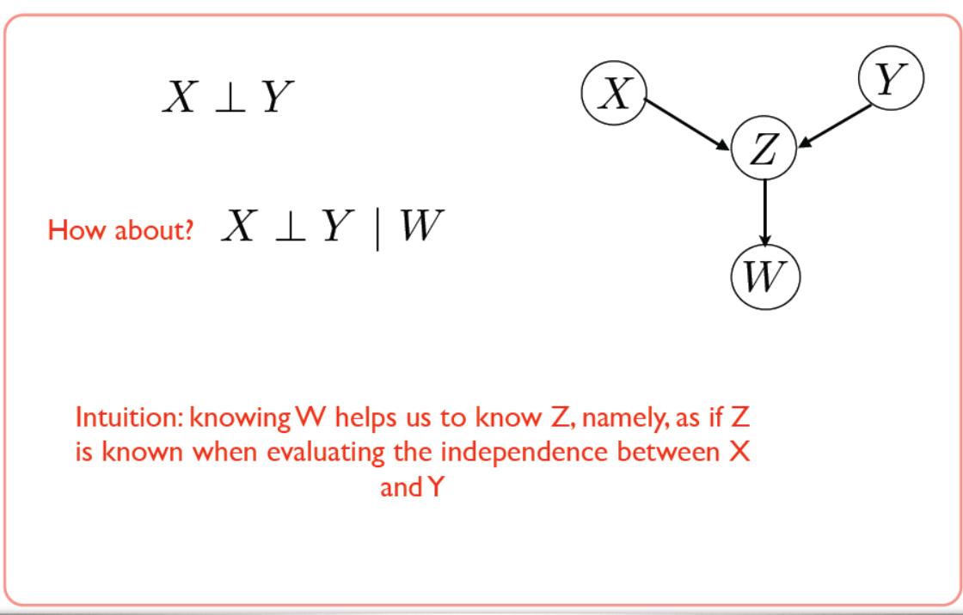
More V Structure

Slide 44
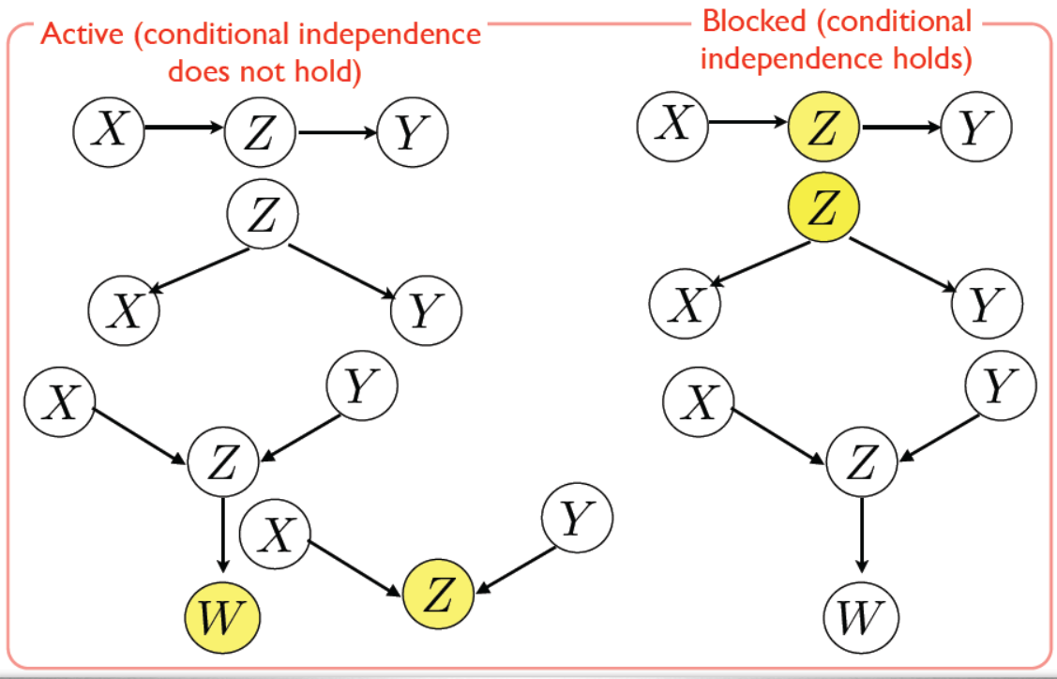
Active and blocked Trail

Slide 45

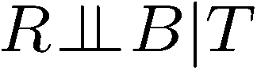
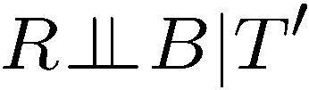
Example
Yes
R
B
T
T’
Notes:
T’: traffic report

Slide 46
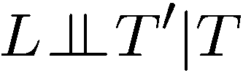

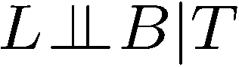
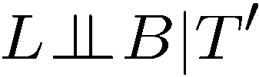
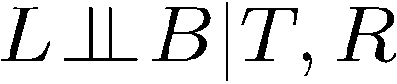
Example
L
Yes
R
B
Yes
D
T
Yes
T’

Slide 47
Inference
Query X: variable for which to compute distribution
Evidence variables E: observed variables for event e
Hidden variables Y: non-evidence, non-query variable.
Goal: Calculate P(X | e)

Slide 48
Inference by Enumeration in Bayes’ Net
Rain
{none, light, heavy}
P(Appointment | light, no)
= α P(Appointment, light, no)
= α [P(Appointment, light, no, on time) + P(Appointment, light, no, delayed)]
Maintenance
{yes, no}
Train
{on time, delayed}
Appointment
{Attend, miss}
Notes:
0.003

Slide 49
Inference by Enumeration in Bayes’ Net
Given unlimited time, inference in BNs is easy
Reminder of inference by enumeration by example:
B
E
A
J
M

Slide 50
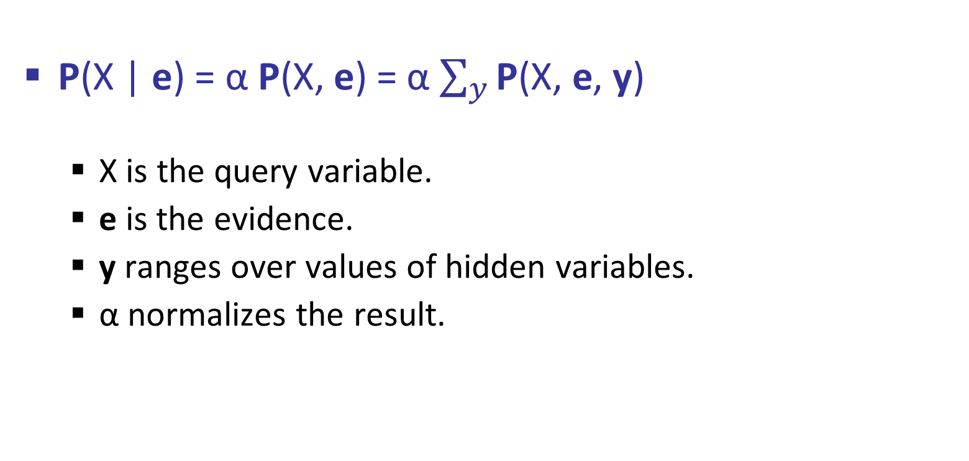
Inference by Enumeration
P(X | e) = α P(X, e) = α $\sum_{y}{\text{P}\text{(}\text{X}\text{, }\text{e}\text{, }\text{y}\text{)} }$
X is the query variable.
e is the evidence.
y ranges over values of hidden variables.
α normalizes the result.

Slide 51
Approximate Inference
Sampling

Slide 52
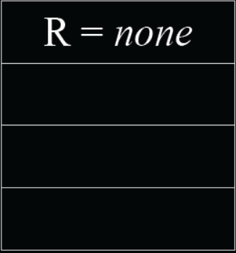
Example: Appointment
Rain
{none, light, heavy}
none | light | heavy
0.7 | 0.2 | 0.1
Notes:
0.003

Slide 53
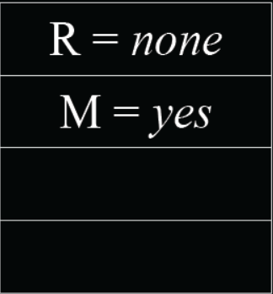
Example: Appointment
Rain
{none, light, heavy}
Maintenance
{yes, no}
R | Yes | No
none | 0.4 | 0.6
light | 0.2 | 0.8
heavy | 0.1 | 0.9
Notes:
0.003

Slide 54

Example: Appointment
R | M | On time | delayed
none | yes | 0.8 | 0.2
none | no | 0.9 | 0.1
light | yes | 0.6 | 0.4
light | no | 0.7 | 0.3
heavy | yes | 0.4 | 0.6
heavy | no | 0.5 | 0.5
Rain
{none, light, heavy}
Maintenance
{yes, no}
Train
{on time, delayed}
Notes:
0.003

Slide 55

Example: Appointment
Rain
{none, light, heavy}
Maintenance
{yes, no}
Train
{on time, delayed}
T | Attend | Miss
On time | 0.9 | 0.1
delayed | 0.6 | 0.4
Appointment
{Attend, miss}
Notes:
0.003

Slide 56

Random Samples
Notes:
0.003

Slide 57
Random Samples
P(Train = on time) ?
Notes:
0.003

Slide 58

Inference using Sampling

Slide 59
Random Samples
P(Rain = light | Train = on time) ?

Slide 60

Inference using Sampling

Slide 61
Bayes Nets Representation Summary
Bayes nets compactly encode joint distributions
Guaranteed independencies of distributions can be deduced from BN graph structure
D-separation gives precise conditional independence guarantees from graph alone
A Bayes’ net’s joint distribution may have further (conditional) independence that is not detectable until you inspect its specific distribution

Slide 62
Uncertainty and Time
Often, we want to reason about a sequence of observations where the state of the underlying system is changing
Speech recognition
Robot localization
User attention
Medical monitoring
Global climate
Need to introduce time into our models

Slide 63
Markov assumption
Markov assumption: The assumption that the current state depends on only a finite fixed number of previous states.
Markov chain: a sequence of random variables where the distribution of each variable follows the Markov assumption

Slide 64

Markov assumption

Slide 65

Markov assumption

Slide 66
Markov Models (aka Markov chain/process)
Value of X at a given time is called the state (usually discrete, finite)
The transition model P(X_{t} | X_{t-1}) specifies how the state evolves over time
Stationarity assumption: transition probabilities are the same at all times
Markov assumption: “future is independent of the past given the present”
X_{t+1} is independent of X₀,…, X_{t-1} given X_{t}
This is a first-order Markov model (a kth-order model allows dependencies on k earlier steps)
Joint distribution P(X₀,…, X_{T}) = P(X₀) ∏_{t} P(X_{t} | X_{t-1})
X₀
X₁
X₂
X₃
P(X₀)
P(X_{t} | X_{t-1})

Slide 67
Markov Models (aka Markov chain/process)
First-order Markov process: the current state depends only on the previous state and not on any earlier states.
P(X_{t} | X_{0:t-1}) =
P(X_{t} | X_{t-1})
Current t-1 state provides enough information to make the future conditionally independent of the past,
Second-order Markov process: The transition model for a second-order Markov process is the conditional distribution
P(X_{t} | X_{t-2} , X_{t-1})
Sensor Markov assumption (observation model)
P(E_{t} | X_{0:t}, E_{0:t-1}) =

Slide 68

Example Markov Chain: Weather
States: X = {rain, sun}
Initial distribution: 1.0 sun
CPT P(X_{t} | X_{t-1}):
Two new ways of representing the same CPT
X_{t-1} | X_{t} | P(X_{t}|X_{t-1})
sun | sun | 0.9
sun | rain | 0.1
rain | sun | 0.3
rain | rain | 0.7
0.9
0.3
0.9
rain
sun
sun
sun
0.1
0.3
rain
rain
0.7
0.7
0.1

Slide 69
Example Markov Chain: Weather
0.9
Initial distribution: 1.0 sun
What is the probability distribution after one step?
0.3
rain
sun
0.7
0.1
Notes:
P(rain) = > P(rain | sun) P(sun) + P (rain|rain) P(rain)
0.1 * 1 + 0.7 * 0 = 0.1

Slide 70


Mini-Forward Algorithm
Question: What’s P(X) on some day t?
X₁
X₂
X₃
X₄
Forward simulation

Slide 71










Example Run of Mini-Forward Algorithm
From initial observation of sun
From initial observation of rain
From yet another initial distribution P(X₁):
P(X₁)
P(X₂)
P(X₃)
P(X₄)
P(X∞)
P(X₁)
P(X₂)
P(X₃)
P(X₄)
P(X∞)
…
P(X₁)
P(X∞)
[Demo: L13D1,2,3]
Notes:
P(sun) = > P(sun | sun) P(sun) + P (sun | rain) P(rain)
0.9 * 0.9 + 0.3 * 0.1 = 0.84
P(rain) = > P(rain | sun) P(sun) + P (rain | rain) P(rain)
0.1 * 0.9 + 0.7 * 0.1 = 0.09 + 0.07 = 0.16

Slide 72
Forward algorithm (simple form)
What is the state at time t?
P(X_{t}) = ∑_{xt-1} P(X_{t},X_{t-1}=x_{t-1})
= ∑_{xt-1} P(X_{t-1}=x_{t-1}) P(X_{t}| X_{t-1}=x_{t-1})
Iterate this update starting at t=0
This is called a recursive update: P_{t} = g(P_{t-1}) = g(g(g(g( …P₀))))
Probability from previous iteration
Transition model

Slide 73
Hidden Markov Models
Markov chains not so useful for most agents
Need observations to update your beliefs
Hidden Markov models (HMMs)
Underlying Markov chain over states X
You observe outputs (effects) at each time step
An HMM is a temporal probabilistic model in which the state of the process is described by a single, discrete random variable
HMMs require the state to be a single, discrete variable, there is no corresponding restriction on the evidence variables.
X₁
X₂
X₃
X₄
X₅
E₁
E₂
E₃
E₄
E₅

Slide 74



Example: Weather HMM
Rain_{t-1}
Rain_{t}
Rain_{t+1}
Umbrella_{t-1}
Umbrella_{t}
Umbrella_{t+1}
Figure 2: Bayesian network structure and conditional distributions describing the umbrella world. The transition model is P(Raint | Raint−1) and the sensor model is P(Umbrellat | Raint).
An HMM is defined by:
Initial distribution:
Transitions:
Emissions:
R_{t} | U_{t} | P(U_{t}|R_{t})
+r | +u | 0.9
-r | +u | 0.1
R_{t-1} | R_{t} | P(R_{t}|R_{t-1})
+r | +r | 0.7
-r | +r | 0.3
Notes:
demo

Slide 75

Formally
X₅
E₅

Slide 76
Example: Weather HMM
On day 0, we have no observations, only the security guard’s prior beliefs; let’s assume that consists of P(R0) = 0.5, 0.5.
B(+r) = 0.5
B(-r) = 0.5
Transition Probabilities
Emission Probabilities
Rain₀
Rain₁
Rain₂
R_{t} | R_{t+1} | P(R_{t+1}|R_{t})
+r | +r | 0.7
+r | -r | 0.3
-r | +r | 0.3
-r | -r | 0.7
R_{t} | U_{t} | P(U_{t}|R_{t})
+r | +u | 0.9
+r | -u | 0.1
-r | +u | 0.2
-r | -u | 0.8
Umbrella₁
Umbrella₂
Notes:
demo

Slide 77


Example: Weather HMM
On day 1, the umbrella appears, so U = true, The prediction from t = 0 to t == 1 is
P(R₁) = ∑_{r0} P(R₁| r0 ) P(r0 )
and updating it with the evidence for t = 1 gives
Transition Probabilities
Emission Probabilities
Rain₀
Rain₁
Rain₂
R_{t} | R_{t+1} | P(R_{t+1}|R_{t})
+r | +r | 0.7
+r | -r | 0.3
-r | +r | 0.3
-r | -r | 0.7
R_{t} | U_{t} | P(U_{t}|R_{t})
+r | +u | 0.9
+r | -u | 0.1
-r | +u | 0.2
-r | -u | 0.8
B(+r) = 0.5
B(-r) = 0.5
Umbrella₁
Umbrella₂
Notes:
P(rain₁) = > P(rain₁ | rain₀) P(rain₀) + P (rain₁ | - rain₀) P(- rain₀)
P(rain₁) = 0.7 * 0.5 + 0.3 * 0.5 = 0.5

Slide 78


Example: Weather HMM
On day 1, the umbrella appears, so U = true, The prediction from t = 0 to t == 1 is
P(R₁) = ∑_{r0} P(R₁| r0 ) P(r0 )
and updating it with the evidence for t = 1 gives
On day 2, the umbrella appears, so U = true, The prediction from t = 1 to t == 2 is
and updating it with the evidence for t = 2 gives
Notes:
P (R1 | u1) = P(u1 | R1) P (R1) / P (u1)
Remove P (u1) for division to get approximation
a = show approximation
P (R1 | u1) = a P(u1 | R1) P (R1)
P (R1 | u1) = 0.45
P(u1) = 0.55
P (R1 | u1) = 0.45 / 1.1
Procedure:
Step 1: Compute Z = sum over all entries
Step 2: Divide every entry by Z

Slide 79
Example: Weather HMM
B’(+r) = 0.5
B’(-r) = 0.5
B’(+r) = 0.627
B’(-r) = 0.373
B(+r) = 0.5
B(-r) = 0.5
B(+r) = 0.818
B(-r) = 0.182
B(+r) = 0.883
B(-r) = 0.117
Transition Probabilities
Emission Probabilities
Rain₀
Rain₁
Rain₂
R_{t} | R_{t+1} | P(R_{t+1}|R_{t})
+r | +r | 0.7
+r | -r | 0.3
-r | +r | 0.3
-r | -r | 0.7
R_{t} | U_{t} | P(U_{t}|R_{t})
+r | +u | 0.9
+r | -u | 0.1
-r | +u | 0.2
-r | -u | 0.8
Umbrella₁
Umbrella₂
Notes:
demo

Slide 80




Example 2: Weather and Mode HMM
Example: Consider the example which elaborates how a person feels on different climates.
Notes:
demo

Slide 81
Example 2: Weather and Mode HMM
Example: Consider the example which elaborates how a person feels on different climates.
Sunny₀
Rain₁
Sunny₂
Happy₀
grumpy₁
Happy₂
Notes:
demo

Slide 82
Example 2: Weather and Mode HMM
Example: Consider the example which elaborates how a person feels on different climates.
Transition Probabilities
Transition Probabilities
8
0.8
S_{t} | S_{t+1} | P(S_{t+1}|S_{t})
sunny | sunny | 0.8
sunny | rainy | 0.2
rainy | rainy | 0.6
rainy | sunny | 0.4
2
0.2
2
0.4
3
0.6
Notes:
demo

Slide 83
Example 2: Weather and Mode HMM
Example: Consider the example which elaborates how a person feels on different climates.
Emission Probabilities
Emission Probabilities
8
0.8
S_{t} | H_{t} | P(H_{t}|S_{t})
sunny | happy | 0.8
sunny | grumpy | 0.2
rainy | happy | 0.4
rainy | grumpy | 0.6
2
0.2
2
0.4
3
0.6
Notes:
demo

Slide 84
Example 2: Weather and Mode HMM
Example: Consider the example which elaborates how a person feels on different climates.
Probability of sunny
Probability of rainy
5 / 15
0.33
10 / 15
0.67
Probability of happy
Probability of grumpy
10 / 15
0.67
5 / 15
0.33
Notes:
demo

Slide 85
Example 2: Weather and Mode HMM
If Happy today, what is probability its sunny or rainy?
S_{t} | H_{t} | P(H_{t}|S_{t})
sunny | happy | 0.8
sunny | grumpy | 0.2
rainy | happy | 0.4
rainy | grumpy | 0.6
P(Sunny|Happy) = P(Happy|Sunny) P(sunny) / P(Happy) => 0.8 * 0.67/ 0.67 => 0.8
P(rainy|Happy) = P(Happy|rainy) P(rainy)/ P(Happy) => 0.4 * 0.33 / 0.67 = 0.2
S_{t} | S_{t+1} | P(S_{t+1}|S_{t})
sunny | sunny | 0.8
sunny | rainy | 0.2
rainy | rainy | 0.6
rainy | sunny | 0.4
Notes:
a = show approximation
P(Sunny|Happy) = a P(Happy|Sunny) P(sunny)
= a 0.8 * 0.67 = 0.536
P (rainy | happy) = a P(Happy|rainy) P(rainy)
= a 0.4 * 0.33 = 0.132
So after approximation ~~ P(Sunny|Happy) = <0.546> = <0.8>

Slide 86
Example 2: Weather and Mode HMM
If Happy-grumpy, what is weather for 2 days?
P(Sunny, Rainy) = P(Sunny) P(Happy | Sunny) P (Rainy | Sunny) P(grumpy | Rainy)
P(Sunny, Rainy) = 0.67 * 0.8 * 0.2 * 0.6 => 0.064
P(Sunny, Sunny) = P(Sunny) P(Happy | Sunny) P (Sunny | Sunny) P(grumpy | Sunny)
P(Sunny, Rainy) = 0.67 * 0.8 * 0.8 * 0.2 => 0.085
P(Rainy, Sunny) = P(Rainy) P(Happy | Rainy) P (Rainy | Sunny) P(grumpy | Sunny)
P(Sunny, Rainy) = 0.33 * 0.4 * 0.4 * 0.2 => 0.010
S_{t} | H_{t} | P(H_{t}|S_{t})
sunny | happy | 0.8
sunny | grumpy | 0.2
rainy | happy | 0.4
rainy | grumpy | 0.6
S_{t} | S_{t+1} | P(S_{t+1}|S_{t})
sunny | sunny | 0.8
sunny | rainy | 0.2
rainy | rainy | 0.6
rainy | sunny | 0.4
Notes:
demo

Slide 87
Filtering / Monitoring
Filtering, or monitoring, is the task of tracking the distribution B_{t}(X) = P_{t}(X_{t} | e₁, …, e_{t}) (the belief state) over time
We start with B₁(X) in an initial setting, usually uniform
As time passes, or we get observations, we update B(X)
The Kalman filter was invented in the 60’s and first implemented as a method of trajectory estimation for the Apollo program.
With HMM infer discrete, finite variable and using Kalman filter we can have inference of continuous variables.

